Slide 1
Interprocess Communication
Processes within a system may be independent or cooperating
Cooperating process can affect or be affected by other processes, including sharing data
Reasons for cooperating processes:
Information sharing
Computation speedup
Modularity
Convenience
Cooperating processes need interprocess communication (IPC)
Two models of IPC
Shared memory
Message passing
Notes:
https://www.tutorialspoint.com/cooperating-process

Slide 2
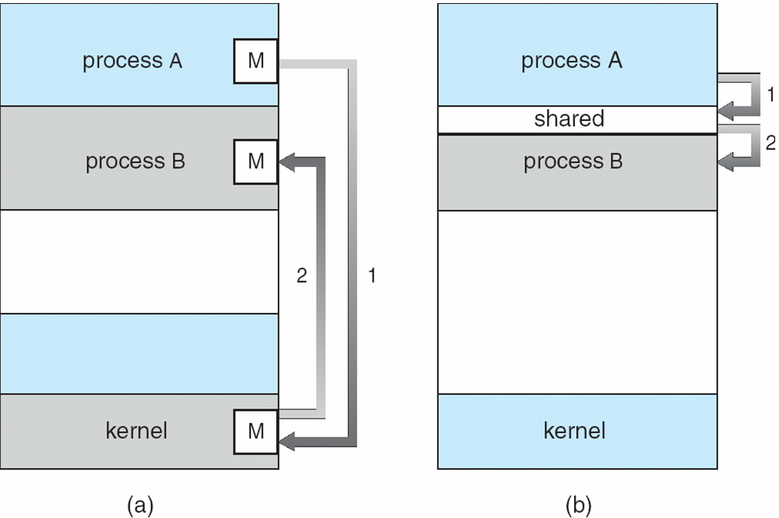
Communications Models

Slide 3
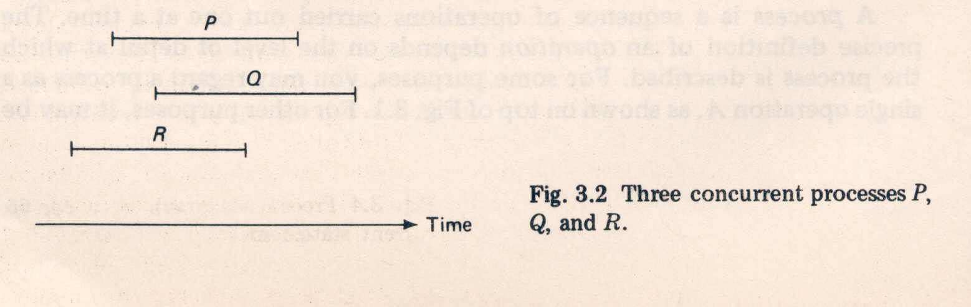
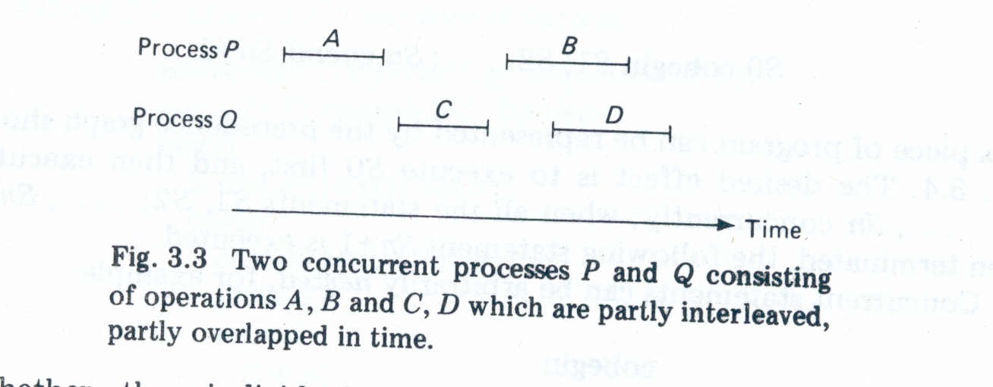
Concurrent Processes
Two processes are said to be concurrent if they over lap in their execution.

Slide 4
Representation
Precedence Graphs:
Consider the following program segment, which performs some simple arithmetic operations.
Program1 :
a : = x + y;
b : = z + 1;
c : = a – b;
w : = c + 1;

Slide 5
Precedence Graph
A precedence graph is a directed acyclic graph whose nodes correspond to individual statements. An edge form node S_{i} to node S_{j} means that statement S_{i} can be executed only after statement S_{i} has completed execution.
S₁
S₂
S₃
S₄
S₅
S₆
S₇

Slide 6
S₂ and S₃ can be executed after S₁ completes.
S₄ can be executed after S₂ completes.
S₅ and S₆ can be executed after S₄ completes.
S₇ can execute only after S_{5’} S_{6’} and S₃ complete.
Note that S₃ can be executed concurrently with S_{2’} S_{4’} S_{5’} and S_{6’}

Slide 7
Concurrency Conditions :
When can two statements in a program be executed concurrently and still produce the same results?
The following three conditions must be satisfied for two successive statements S₁ and S₂ to be executed concurrently and still produce the same result. It is known as Bernstein’s conditions.
R(S₁) ∩ W(S₂) = {}
W(S₁) ∩ R(S₂) = {}
W (S₁) ∩W(S₂) ={}
R(S_{I}) = {a_{1’} a_{2’} …’ a_{m}}’ the read set for S_{i ’} is the set of all variables whose values are reference in statement S_{i ‘} during its execution.
W(S_{i}) = {b_{1’} b_{2’} …’ b_{n}}’ the write set for S_{i ’} is the set of all variables whose values are changed (written) by the execution if statement S_{i ’}

Slide 8
Example :
S₁: a := x + y
S₂: b := z + 1
S_{3:} c := a – b
S1 and S2 statements can be executed concurrently because :
R(S₁) = {x, y}
R(S₂) = {z}
W(S₁) = {a}
W((S₂)= {b}
However, S₂ cannot be executed concurrently with, since
W(S₂) ∩ R(S₃) = {b}

Slide 9
Implementing Concurrency
The Fork and Join Constructs:
Conway [1963] and Dennis and Van Horn [1966].
S₁
S₁; fork L; S₂; . . . L : S₃;
Fork
S₂
S₃

Slide 10
The fork L instruction produces two concurrent executions in a program.
One execution starts at the statement labeled L, while the other is the continuation of the execution at the statement following the fork instruction.
When the fork L statement is executed, a new computation is started at S₃. This new computation executes concurrently with the old computation, which continues at S₂.

Slide 11
JOIN > The join instruction provides the means to recombine two concurrent computations into one. > Each of the two computations must request to be joined with the other. > Since computations may execute at different speeds, one may execute the join before the other.

Slide 12
count := 2;
fork L1;
. .
.
S₁;
go to L2;
L1: S₂;
L2: join count;
S₂
S₁
join
S₃

Slide 13
S₁: a := x + y
S₂: b := z + 1
S_{3:} c := a – b
S_{4:} w : = c + 1;
count: = 2;
fork L1;
a := x + y;
Go to L2;
L1: b: = z + 1;
L2: join count;
c := a – b;
w := c + 1;

Slide 14
Concurrent Statements:
A higher-level language construct for specifying concurrency is the parbegin/parend statement of Dijkstra [1965a], which has the following form:
parbegin S₁; S₂; ……S_{n} parend;
Each S_{i} is a single statement.
All statements enclosed between parbegin and parend can be executed concurrently.
S₀
S₁
S₂
S_{n}
S_{n+1}

Slide 15
S₁: a := x + y S₂: b := z + 1 S_{3:} c := a – b S_{4:} w : = c + 1 begin parbegin a : = x + y; b : = z + 1; parend; c : = a – b; w : = c + 1; end.

Slide 16
S₁
S₂
S₃
S₄
S₆
S₅
S₇

Slide 17
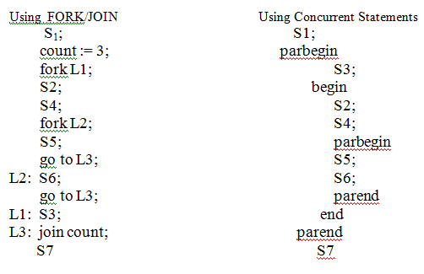
Implementation of Precedence Graph :

Slide 18
Inter Process Communication
Producer Consumer problem is quite common in operating systems.
A Producer process produces information that is consumed by a Consumer process.
A line Printer driver produces characters which are consumed by the Line Printer.
A Compiler may produce assembly code which is consumed by an assembler. The assembler in turn may produce Load modules which are consumed by the loader.

Slide 19
Producer-Consumer Processes:
For maximizing throughput and better system performance, approaches should be made to allow P-C processes to run concurrently.
Producer should produce into Buffer and Consumer should consume from buffer.
A Producer can produce into one buffer while the consumer is consuming from other buffer. P-C must be synchronized so that Consumer does not try to consume items which are not yet been produced.

Slide 20
Unbounded Buffer Producer-Consumer :
No limit on the size of the buffer.
The consumer may have to wait for new items, but the producer can always produce new items i.e. buffers are of unlimited capacity there are always empty buffers.
Bounded Buffer Producer-Consumer : Assumes that there is a fixed buffer size.
Note: The buffer will be provided by the use of shared memory.

Slide 21
Solution to Bounded Buffer Problem :
Data Structure :
1. Circular Array ( shared Pool of Buffers)
2. Two Logical Pointers : ‘in’ and ‘out’
in points to the next free position in the buffer.
out points to the first full position in the buffer.
3. integer variable counter initialized to 0 .
empty: in=out
Full: in+1 mod n =out
counter is incremented every time a new full buffer is
added to the pool and decremented whenever one is
consumed

Slide 22
Type item = ….;
Var buffer : array[0..n-1] of item;
in, out : 0..n-1
nextp, nextc : item; in := 0, out := 0;
Counter:=0;

Slide 23
parbegin
Producer: begin
repeat
…..
produce an item in nextp
…..
while counter =n do skip;
buffer[in] := nextp;
in := in+1 mod n;
counter := counter + 1;
until false;
end;
Consumer: begin
repeat
…..
while counter = 0 do skip; nextc := buffer[out];
out := out+1 mod n;
counter := counter - 1;
consume the item in nextc;
until false;
end;
parend;

Slide 24
This implementation may lead to wrong values, if concurrent execution is uncontrolled
If counter value is currently 5, and Producer is executing the statement
counter := counter +1
and Consumer is executing the statement counter:= counter -1
concurrently, then the value of counter may be
4,5 or 6. ( correct answer should be 5 because
one produced one consumed)

Slide 25
How counter may be incorrect ?
i) counter := counter +1 is implemented in machine language as :
R1 := counter
R1 := R1 +1
Counter := R1
ii) counter := counter -1 is implemented in machine language as :
R2 := counter
R2 := R2-1
Counter := R2

Slide 26
Concurrent execution of statements counter := counter +1 and counter := counter –1 is equivalent to a sequential execution where the lower level statements presented above are interleaved in some arbitrary order. If one such interleaving is :
T0: Producer executes R1 := counter {R1=5}
T1: Producer executes R1 := R1+1 {R1=6}
T2: Consumer executes R2 := counter {R2=5}
T3: Consumer executes R2 := R2-1 {R2=4}
T4: Producer executes Counter := R1 {counter=6}
T5: Consumer executes Counter := R2 {counter=4}
counter = 4 while answer should be 5.
If T4 and T5 reversed then incorrect counter = 6.

Slide 27
WHY INCORRECT ? Because we allowed processes to manipulate
the variable counter concurrently.
REMEDY : We need to ensure that only one process at a
time may be manipulating the variable counter.
This observation leads us to problem of CRITCIAL SECTION (CS) and the part of the program code where process is executing shared variable is known as its Critical Section.

Slide 28
Problem Definition:
Consider a system consisting of n cooperating processes { P1, P2,.. Pn}
Each process has a segment of code called a Critical Section (CS)
When one process is executing in its CS no other process is to be allowed to execute in its CS.
Thus the execution of CS by the processes in Mutually Exclusive in time.

Slide 29
Critical Section Problem :
To design a protocol which the processes may use to cooperate.
General structure may be:
……
Entry Section
……
Critical Section
…….
Exit Section
Remainder Section

Slide 30
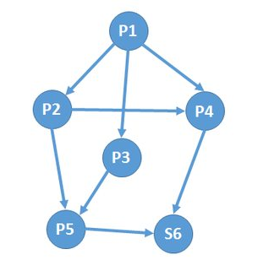

Slide 31
x=2; y=2; z=2;
p1;
Fork L1 ;
Fork L2 ;
goto L3 ;
L1: p2;
fork L3 ;
goto L5
L3: join (x)
P4;
L4: join(y)
s6;
Quit();
L2 : P3;
L5: join(z)
P5;
goto L4

Slide 32
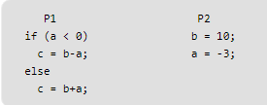
Consider the following C code for process P1 and P2. a=4, b=0, c=0 (initialization)
If the processes P1 and P2 executes concurrently (shared variables a, b and c), which of the following cannot be the value of ‘c’ after both processes complete?
(A) 4 (B) 7 (C) 10 (D) 13
Answer: (C) Explanation:
P1 : 1, 3, 4 -> c = 0+4 =4 {hence option a} P2 : i, ii and P1 : 1, 2 -> c = 10-(-3) = 13 {hence option d} P1 : 1 , P2 : i, ii and P1 : 3, 4 -> c= 10+(-3) = 7 { hence option b} So 10 cannot be c value.

Slide 33
The following two functions P1 and P2 that share a variable B with an initial value of 2 execute concurrently.
P1() P2()
{ {
C = B – 1; D = 2 * B;
B = 2*C; B = D - 1;
} }
The number of distinct values that B can possibly take after the execution is
(A) 3 (B) 2 (C) 5 (D) 4
Ans: A

Slide 34
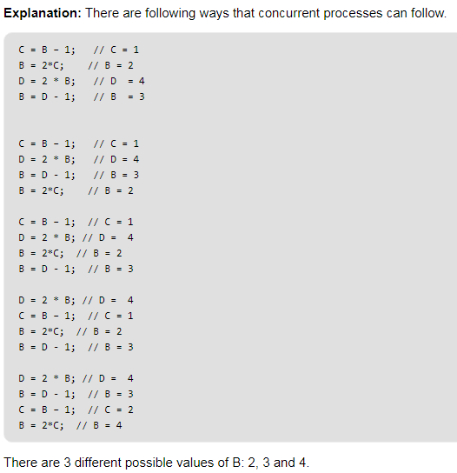

Slide 35
A solution to the critical-section problem must satisfy the following 3 requirements :
Mutual Exclusion :
If process P_{i} is executing in its CS then no other process can be
executing in their CS.
Progress:
If no process is executing in its CS and there exist some processes that wish to enter their CS then only those processes that are not executing in their Remainder Section can participate in the decision as to who will enter the CS next, and this election can’t be postponed indefinitely
. Bounded Waiting :
There must exist a bound on the times that other processes are allowed to enter their CS after a process has made a request to enter its CS and before that is granted.

Slide 36
TWO PROCESS SOFTWARE SOLUTION :
General structure :
begin
common variable decl.
parbegin
P0;
P1;
parend
end.

Slide 37
Algorithm 1:
First approach is to let the processes share a common integer variable turn initialized to 0(or 1). If turn = i then process Pi is allowed to execute in its CS.
Pi :
repeat
while turn <> i do skip;
C.S
turn := j ;
Remainder section
until false
Analysis:
Ensures only one process at a time can be in CS. STRICT ALTERNATION of processes in CS.
However it does not satisfy the progress requirement.

Slide 38

Algorithm 2:
var flag : array[0..1] of boolean ; (initial to 0)
If flag[i] is true then Pi is executing in its CS.
Pi :
repeat
while flag[j] do skip;
flag[i] := true;
CS;
flag[i] := false;
Remainder section ;
until false

Slide 39
Analysis:
ME is not Ensured :
T0 : P0 enters the while statement and finds flag[1] = false
T1 : P1 enters the while statement and finds flag[0] = false
T2 : P1 sets flag[1] and enters CS.
T3 : P0 sets flag[0] and enters CS.
Progress Satisfied

Slide 40
Algorithm 3:
repeat
flag[i] := true;
while flag[j] do skip;
critical section
flag[i] := false;
remainder section ;
until false

Slide 41
Analysis:
The mutual–exclusion requirement is satisfied. Unfortunately, the progress requirement is not met. To illustrate this problem, consider the following execution sequence.
T₀: P₀ set flag [0] = true.
T₁: P₁ set flag [1] = true.
Now P₀ and P₁ are looping forever in their respective while statements

Slide 42
Algorithm 4 :
However, we now (finally) present a correct solution, due to Peterson [1981]. This solution is basically a combination of Algorithm 3 and a slight modification of Algorithm 1.

Slide 43
The processes share two variables in common:
var flag : array[0..1] of boolean ;
turn : 0..1;
Initially flag[0] = flag[1] = false and the value of turn is immaterial (but either 0 or 1).
P_{i} :
repeat
flag[i] := true;
turn := j;
while (flag[j] and turn=j) do skip;
critical section
flag[i] := false;
remainder section
until false;

Slide 44
Semaphores
The solutions to the mutual exclusion problem presented in the last section are not easy to generalize to more complex problems.
To overcome this difficulty, a new synchronization tool, called a semaphore, was introduced by Dijkstra .
A semaphore S is an integer variable that, apart from initialization, can be accessed only through two standard atomic operations: P and V.
The classical definitions of P and V are:
P(S): while S <= 0 do skip;
S : = S – 1;
V(S): S: = S + 1;

Slide 45
When one process modifies the semaphore value, no other process can simultaneously modify that same semaphore value.
In addition, in the case of the P(S), the testing of the integer value of S(S ≤ 0), and its possible modification (S := S – 1) must also be executed without interruption.

Slide 46
Usage
Semaphores can be used in dealing with the n-process critical section problem. The n processes share a common semaphore, mutex, initialized to 1. Each process P_{i} is organized as follows:
repeat
P(mutex);
critical section
V(mutex);
remainder section
until false;

Slide 47
Semaphores as Synchronization Tool
S₁
S2
Consider two concurrently running processes: P₁ with a statement S₁, and P₂ with a statement S₂. Suppose that we require that S₂ be executed only after S1 has completed. This scheme can be readily implemented by letting P₁ and P₂ share a common semaphore synch, initialized to 0, and by inserting the statements:
S_{1;}
V(synch); in process P_{1,} and the statements
P(synch);
S_{2;} in process P_{2.}
Since synch is initialized to 0, P₂ will execute S₂ only after P₁ has invoked V(synch), which is after S₁.

Slide 49
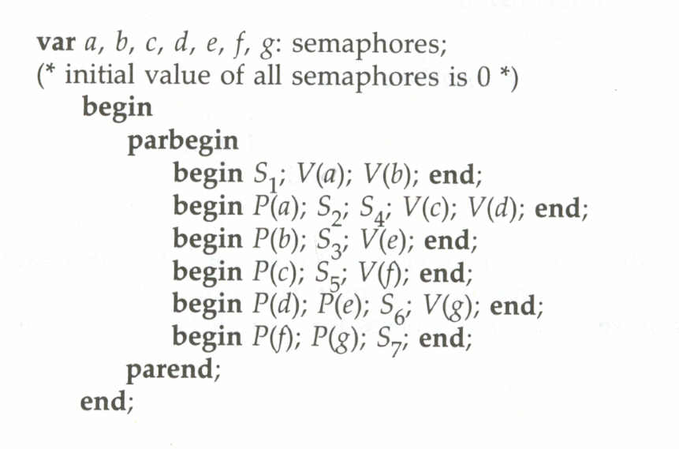

Slide 50
Problem in this implementation of semaphore
Whenever any process waits then it continuously checks for semaphore value (look at this line while (s==0); in P operation) and waste CPU cycle. To avoid this another implementation is proposed.

Slide 51
Semaphore definition with out busy-waiting
To implement semaphore for avoiding busy-waiting we define a semaphore as a record.
type semaphore = record
Value: integer;
L: list of process;
end;
Each semaphore has an integer value and a list of processes. When a process must wait on a semaphore, it is added to the list of processes. A V operation removes one process from the list of waiting processes and awakens it.

Slide 52
P(S):
S. value := S. value – 1;
if S. value < 0
then begin
add this process to S.L;
block;
end;
V(S):
S. value := S. value + 1;
if S.value ≤ 0
then begin
remove this process P from S.L;
wakeup(P);
end;

Slide 53
Process | Operations | CS | Blocked | S
A | P(S) | A
A | V(S) | -
B | P(S) | B
C | P(S) | B
D | P(S) | B
E | P(S) | B
B | V(S) | C
F | P(S) | C
C | V(S) | D
D | V(S) | E
E | V(S) | F
F | V(S) | -
- | 0
- | 1
- | 0
C | -1
C,D | -2
C,D,E | -3
D,E | -2
D,E,F | -3
E,F | -2
F | -1
- | 0
- | 1

Slide 54
Hardware Solutions
Many machines provide special hardware instructions that allow :
one to either test and modify the content of a word,
or to swap the contents of two words, in one memory cycle.
These special instructions can be used to solve the critical section problem.

Slide 55
Function Test-and-Set(var target: boolean): boolean;
begin
Test-and-Set := target;
target := true;
end;
The important characteristic is that these instructions are executed atomically; that is, in one memory cycle. Thus if two Test-and Set instructions are executed simultaneously (each on a different cpu), they will be executed sequentially in some arbitrary order.

Slide 56
If the machine supports the Test-and Set instruction, then mutual exclusion can be implemented by declaring a boolean variable lock, initialized to false.
repeat
while Test-and Set(lock) do skip;
critical section
lock := false;
remainder section
until false;

Slide 57
Swap Instruction
Procedure Swap (var a, b: boolean);
var temp: Boolean;
begin
temp := a:
a := b;
b := temp;
end;

Slide 58
If the machine support the Swap instruction, then mutual exclusion can be provided in a similar manner.
A global boolean variable lock is initialized to false. Each process also has a local boolean variable key.
repeat
key := true;
repeat
Swap(lock, key);
until key = false;
critical section
lock := false;
remainder section
until false;

